Slide 1

Optimizing Return of Investments: Identifying the Most Profitable Property Type and Neighbourhoods for Short-stay Rentals in New York
Business Analysis by Patricia May Reyes
RMITO Business Analytics and Visualisation

Slide 2

Which property type and neighbourhood combination offers the highest potential return on investment for short-stay rentals in New York?
The purpose of this business analysis project was to gain insights into the New York short-stay rental market using Airbnb listings data.
The analysis considered factor such as neighbourhood popularity, preferences on property type and room type, selling points, and pricing dynamics.

Slide 3
Ethical and Legal Considerations on Data Privacy
Data Ethics and Legislation Checklist | Checked? | Action Done
1. Consensually collected personal data should not identify individuals | Yes | Exclusion of Host identities to maintain privacy and confidentiality
 |  | Exact addresses of each property are not disclosed to protect the security of hosts and guests
2. Provisions about the use of shared data with third parties should specify restrictions on how they share their data | Yes | Data will not be republished.
3. Individuals are informed at the point of data collection about how their data may be used or sold. | Yes | The use of the data is to quantify short-term rentals.
4. Decisions and predictions made from the use of personal data should be legal and ethical | Yes | Prioritizes the protection of host identities and exact addresses by refraining from displaying data that will show personal information
5. Use of data should not enshrine unconscious and unfair bias | Yes | To reduce the risk of bias, different charts were displayed to identify the most profitable neighbourhood and property type.
6. Data analysts shouldn’t cushion decision-makers from data that reveals problems in the organisation's performance. | Yes | Data is presented as it is without any attempts to manipulate findings.
7. Ensure that all data-related practices comply with relevant legislation and regulations, such as the General Data Protection Regulation (GDPR) and Privacy Act 1988 (Australia). | Yes | Only use minimum amount of personal data necessary to achieve the objective of the analysis.

Slide 4
Data Cleaning Checklist | New York Listing Dataset
1. Create a backup copy. | Done
2. Check the format of your data. | Done
2.1 Is it in tabular format? | Yes
2.2 Are all the rows and columns showing? | Yes
3. Spell Check. | Yes
3. 1 Identify and correct any inconsistencies or typos in the data. | Not Applicable
4. Text check - find | Not Applicable
5. Text Check - change cases | Yes
5.1 Check that data formats are consistent across the dataset. | Change DUMBO to Dumbo
6. Check records with spaces or non-printing characters in the data. | Change spaces in the STATE column to NY
7. Remove duplicate records in the dataset. | No duplicates found
8. Are there any merging and splitting done? | Not Applicable
Data Cleaning Checklist

Slide 5

What is the most popular neighborhood in New York?

Slide 6
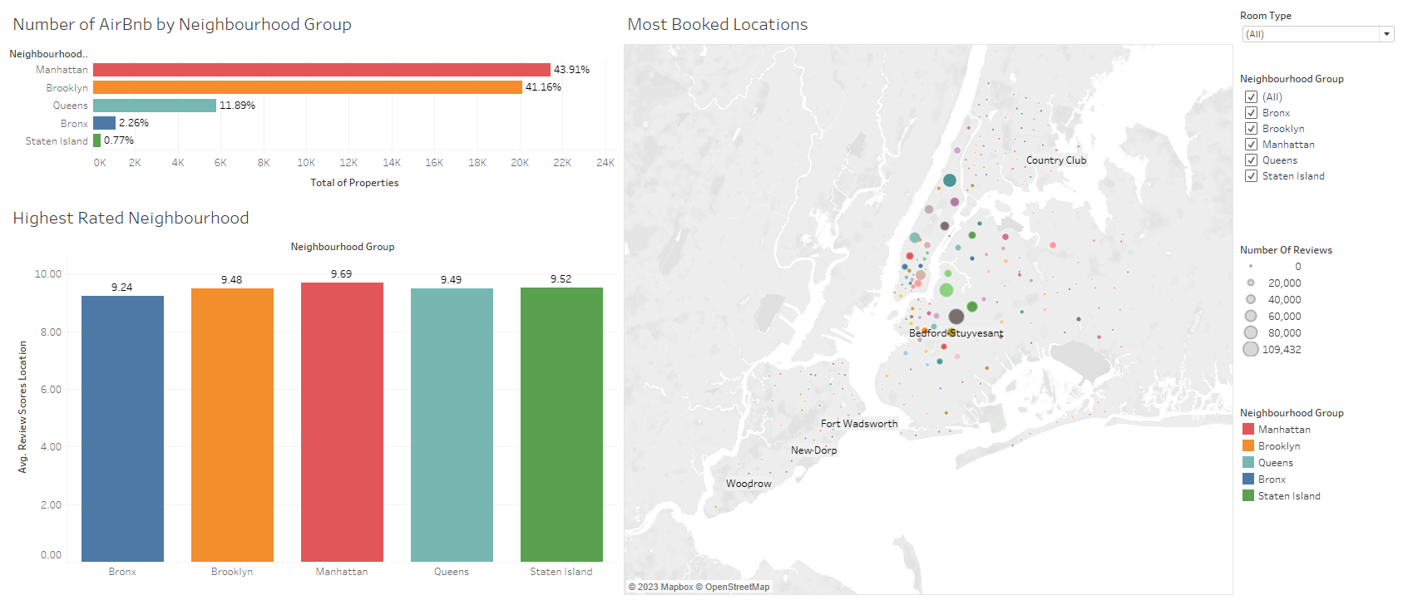

Slide 7

What are the popular Room Types and Property Types in New York?

Slide 8
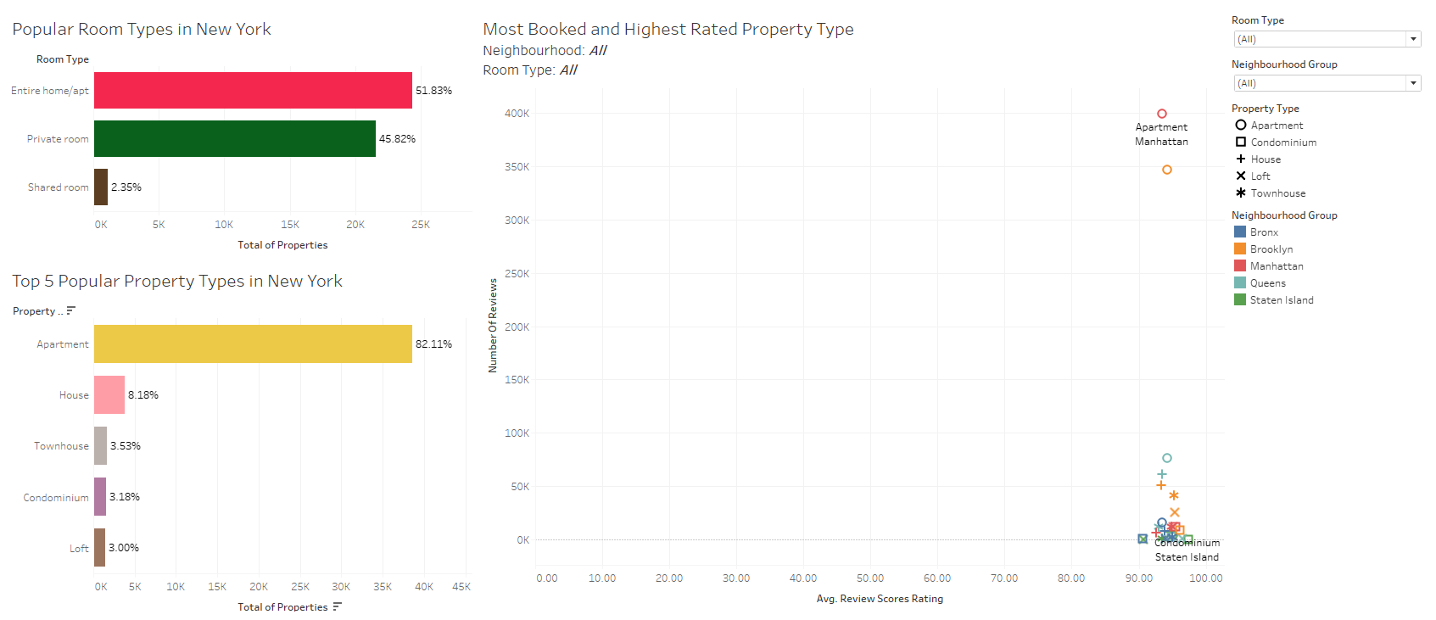

Slide 9

What are the selling points of the short-stay rentals in New York?

Slide 10
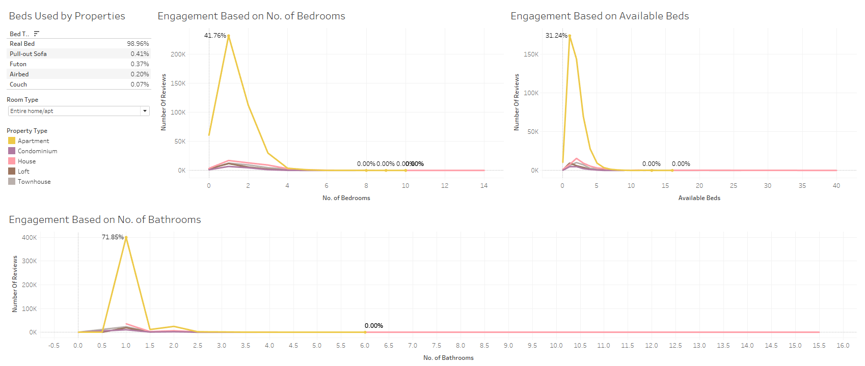

Slide 11

What is the average nightly rate in short-stay rentals in New York City?

Slide 12
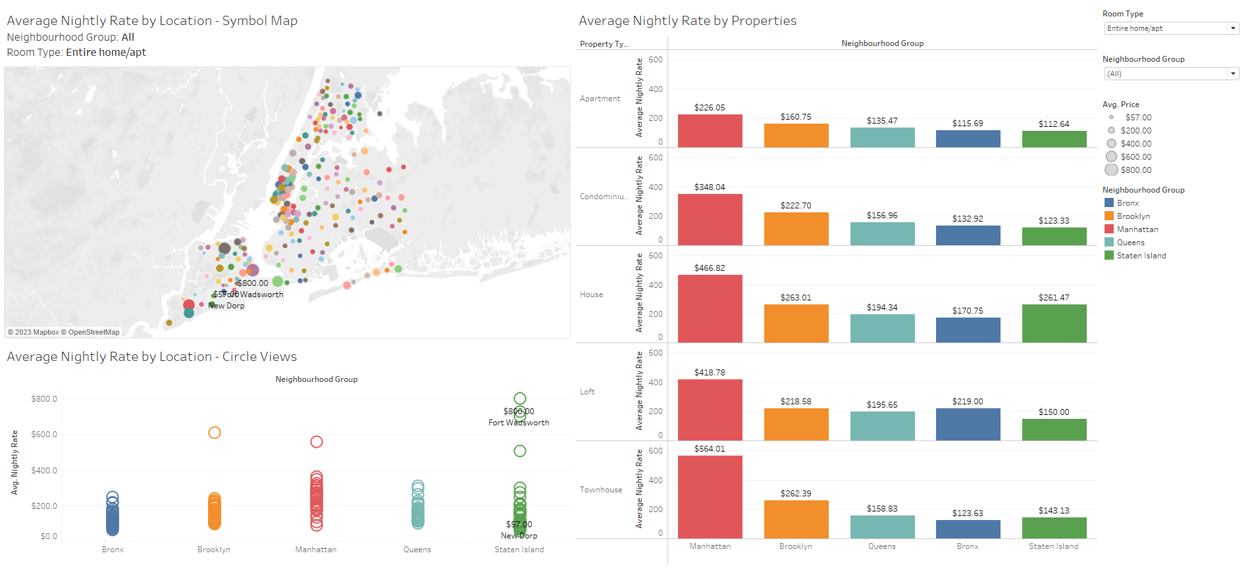

Slide 13

What is the average monthly revenue of short-stay rentals in New York?

Slide 14
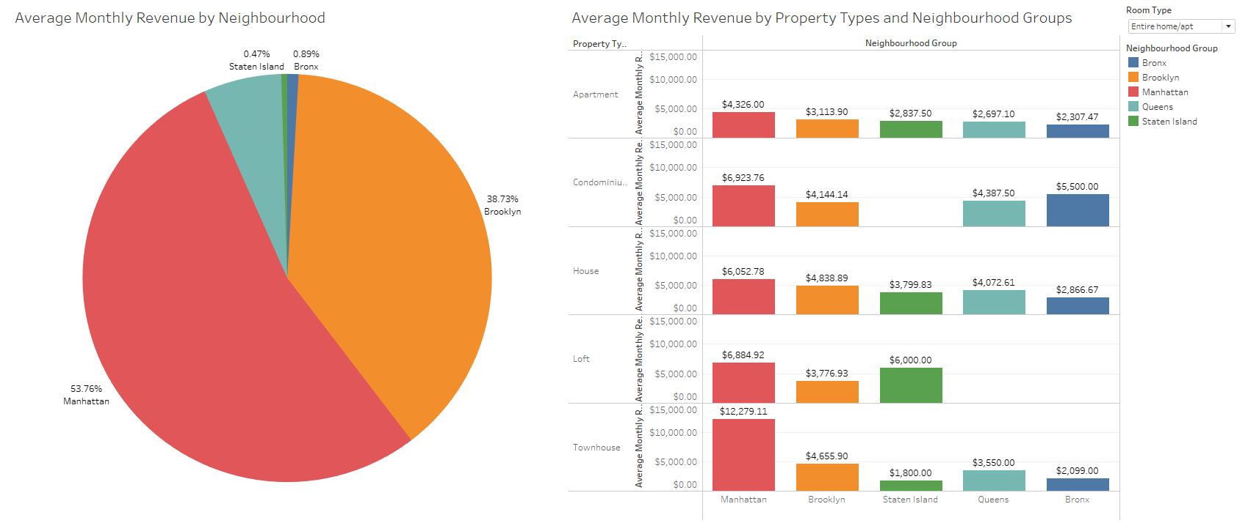

Slide 15

Conclusion
The analysis reveals that Manhattan is the most popular neighbourhood group for short-stay rentals in New York, with high engagement levels and positive guest reviews.
Brooklyn follows closely behind, showcasing its popularity among travellers. Bedford-Stuyvesant in Brooklyn emerges as the most booked location, offering an attractive alternative to Manhattan.
The preferences and trends indicate that travellers prefer Entire Home/Apt for room types and apartments dominate the property types.
Selling points include the preference for real beds, the appeal of one-bedroom apartments, and the availability of beds and bathrooms to accommodate different group sizes.
Pricing dynamics highlight variations across locations and neighbourhood groups, with higher rates in Staten Island.
The average monthly revenue distribution emphasizes the dominance of Manhattan and Brooklyn. Townhouses in Manhattan generate the highest revenue, but it is important to consider engagement levels and property types within neighbourhoods.
These insights provide valuable guidance for investors and property owners seeking the highest return on investment in New York's short-stay rental market.

